Slide 1
Problem Solving (Algorithm) Techniques
Brute-force or exhaustive search
Divide and Conquer
Greedy Algorithms
Dynamic Programming
Branch and Bound Algorithm
Randomized Algorithm
Backtracking

Slide 2
1. Brute-Force
Simple, Straight Forward
Example: Padlock with 4 Digits, Exhaustive Search of Lost Articles in Home.

Slide 3
2. Divide and Conquer
Problem divided into sub problems, sub problems are solved independently and merge the solutions of sub problem for final solution of the problem.
Example: Counting the coins by grouping them into denomination.

Slide 4
3. Greedy Algorithm
Decisions are taken based on Local Optimal Solution at every stage.
Travelling from Kanyakumari to Kashmir by visiting all the states capital.

Slide 5
4. Dynamic Programming
Mathematical Optimization Problem
Breaks the problem into sub problems, solve the sub problems over time as sequence to reach the final solution.
Uses Recursion
Example: Arranging the cards for rummy game.

Slide 6
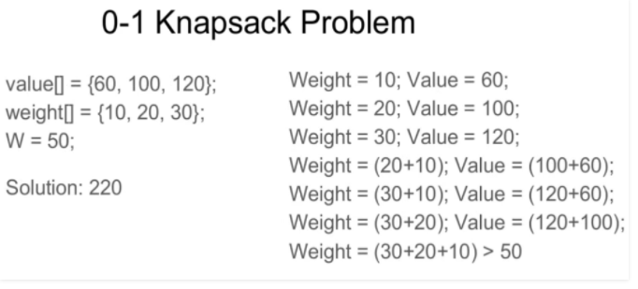
5. Branch and Bound – Combinatorial Optimization

Slide 7
6. Randomized Algorithm
Random Numbers for Decision Making & Optimization.
Accidently Good
Feedback Assessments, Surprise Checks, etc.

Slide 8
7. Back Tracking
Incremental Approach
Uses the previous stage solution to next stage solution
Examples: Crossword

